Slide 1

Building Deep Neural Networks
with
Daniel L. Silver, Ph.D.
Andy McIntyre, Ph.D.
June 24, 2022

Slide 2
Outline
Background
Problem of vanishing gradient
Beyond two hidden layers
Methods of overcoming the problem
Long patient training
Better activation functions
Pre-training
Constrained internal representation - weight-sharing
Better regularizers (sparsity, weight-decay, dropout, injected noise)
Demo using many layers

Slide 3
Background – Why Deep Networks?
Accuracy.
Applications:
Image classification (ImageNet, medical analyses)
Voice recognition (Amazon Echo, Google Home)
Human competitve results (Game of GO)

Slide 4
Exploding or Vanishing (Unstable) Gradients
What happens to the magnitude of the gradients as we backpropagate through many layers?
If the weights are big the gradients grow exponentially (explode)
If the weights are small, the gradients shrink exponentially (vanish)
Typical feed-forward neural nets can cope with these exponential effects because of few hidden layers
Deep Networks
Exploding gradient - clip the weights
Vanishing gradient - bigger problem
Why?
Details: https://ayearofai.com/rohan-4-the-vanishing-gradient-problem-ec68f76ffb9b

Slide 5
Vanishing Gradient
Lowest layers of MLP do not get trained well
Leads to very slow training - especially in lower layers
Top couple layers can usually learn any task "pretty well”
The error to lower layers drops quickly
Lower layers never get the opportunity to use their capacity to improve results, they just create a random feature map
Need a way for early layers to do effective work
Notes:
If weights were large gradient could explode as go down the net –much less common but still can happen
Note large weights usually lead to saturation and even smaller f’(net)
: Another important reason error is low. Final layer updates weights so that overall accuracy is pretty good just based on the last hidden layer (and the still pretty much initial weights of the earlier layers). Thus T-Z already gets small pretty fast based on just the learning of the last few layers using the initial layers as a random shuffle.
Local minima? Some say, More likely difficult slow curvatures (Martens: Hessian Free Learning), Properly tuned Moment with proper initial conditions can make a big difference.
LSTM are more specialized approach for very long memory cases, but is it best for typical tasks? Hessian free claims to out-perform it and can also do the specialized tasks

Slide 6
Overcoming Vanishing/Exploding Gradient
Perform long patient training
small learning rates
Better weight initialization
Normalize output between layers
Use parallel processing - GPUs, etc.
Better activation function
Regularization
Notes:
Usually more nodes in internal layers than input layer, layers not same size
Save this until later slide which has it.: Another important reason error is low. Final layer updates weights so that overall accuracy is pretty good just based on the last hidden layer (and the still pretty much initial weights of the earlier layers). Thus T-Z already gets small pretty fast based on just the learning of the last few layers using the initial layers as a random shuffle.
RLEs, constant derivate, thus just can treat as 1 and scale with LR. 0 once saturated, can come back? Review these more before next time
Evidence that tanh and other activations better than sigmoid for avoiding early top layer saturation

Slide 7
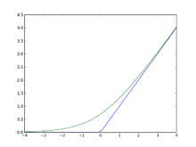
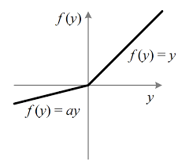
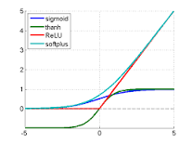
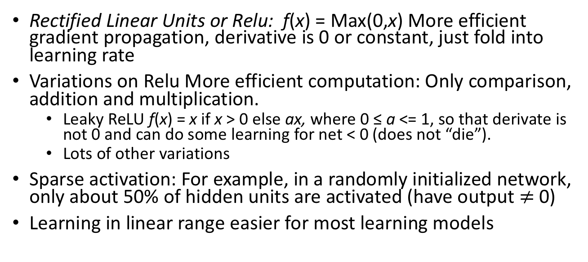
Better Activation Functions
Rectified Linear Units or Relu: f(x) = Max(0,x) More efficient gradient propagation, derivative is 0 or constant, just fold into learning rate
Variations on Relu More efficient computation: Only comparison, addition and multiplication.
Leaky ReLU f(x) = x if x > 0 else ax, where 0 ≤ a <= 1, so that derivate is not 0 and can do some learning for net < 0 (does not “die”).
Lots of other variations
Sparse activation: For example, in a randomly initialized network, only about 50% of hidden units are activated (have output $≠$0)
Learning in linear range easier for most learning models
Notes:
Green is softplus function f(x) = ls(1+e^x) (smooth version of RLU), whose derivative is the sigmoid 1/(1+e^-x)
For regular ReLU, set bias slightly positive, so that active to start with
Leaky ReLU f(x) = x if > 0 else .01x – some effect for x < 0
Note ReLU is not everywhere differentiable. At 0 just choose left or right derivative (0 or 1) and works fine empirically, though theoretically a bit bothersome – Note that since net is real number the prob(0) = 0 anyways and if computer has 0, probably just a representation issue and we would be a little to the left or right anyways in a true system.
So why not same with threshold function? Derivate would be 0 everywhere with no learning
Principle: Nets easier to optimize when there behavior is closer to linear
Still learning why ReLUs work as well as they do

Slide 8
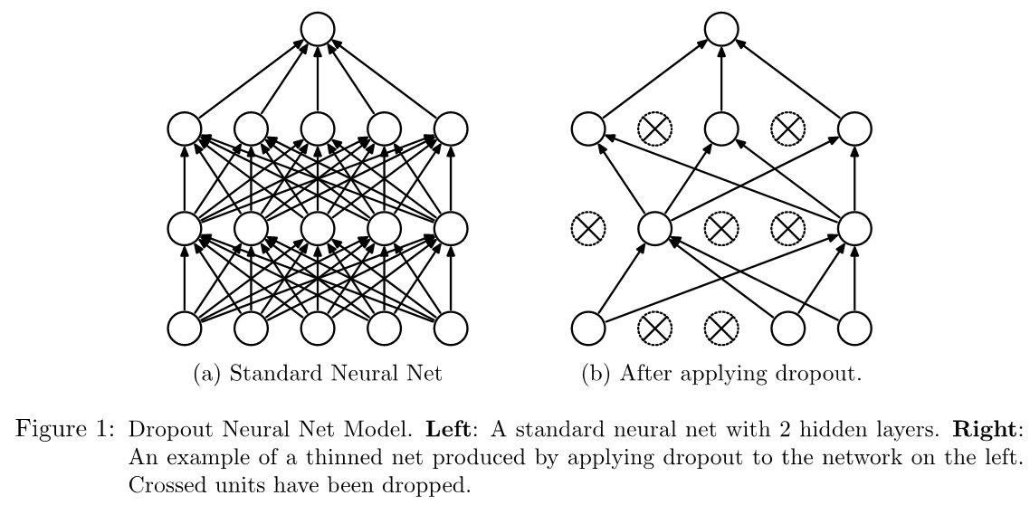
Better Regularization of Free Parameters
Weights (free parameters) make the ANN model
Beyond the training examples we can control weights
Momentum
Weight-decay
Normalization
Sparsity
Dropout
Injected noise

Slide 9


Pre-training of Deep Learning Architectures
Geoff Hinton and Yoshua Bengio (2007+)
Learning Internal Representations
Layered networks of unsupervised auto-encoders efficiently develop hierarchies of features that capture regularities in their respective inputs
Auto-encoders
Restricted Boltzmann Machines
Can be used to develop models for families of tasks

Slide 10
Autoencoders using BP ANN
Learn to predict their input at the output
Learn an internal representation (encoding) of image
Feature detectors of the input
Can be used to pre-train a classifier
Feed a standard
BP ANN to do Classification

Slide 11
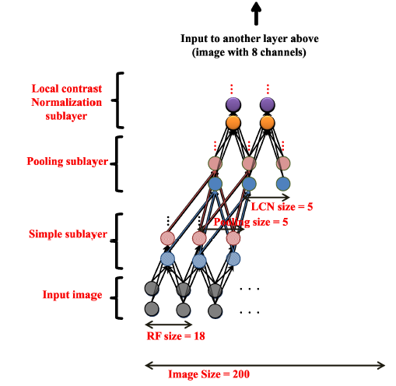
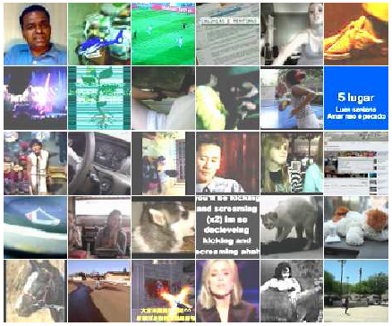
Deep Learning Architectures
Andrew Ng’s work on Deep Learning Networks (ICML-2012)
Problem: Learn to recognize human faces, cats, etc from unlabeled data
Dataset of 10 million images; each image has 200x200 pixels
9-layered locally connected neural network (1B connections)
Parallel algorithm; 1,000 machines (16,000 cores) for three days
Building High-level Features Using Large Scale Unsupervised Learning
Quoc V. Le, Marc’Aurelio Ranzato, Rajat Monga, Matthieu Devin, Kai Chen, Greg S. Corrado, Jeffrey Dean, and Andrew Y. Ng
ICML 2012: 29th International Conference on Machine Learning, Edinburgh, Scotland, June, 2012.

Slide 12

TUTORIAL 4
Demonstrate how the addition of hidden layers makes the development / training of a BP network more challenging
Try the python code tf.keras_mnist_deep.ipynb
For more, check out the following tutorial: https://www.tensorflow.org/tutorials/keras/basic_classification

